Slide 1
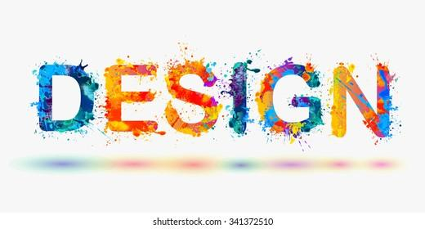

Slide 2

1-Introduction (10 min)Explain AI in design, introduce design specifications, and do a quick poll.
2-“AI Shape Creator” Game (20 min)Students create 3 shapes in teams using AI, reflecting on the process.
3-“AI Artist Showcase” & Gallery Walk (15 min)
Showcase designs, give peer feedback on AI’s impact.

Slide 3
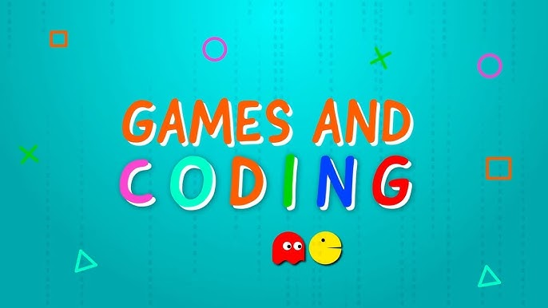
Unit 2: game programming

Slide 4
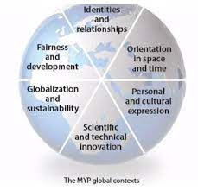
Unit 2: game programming
Global Context: Scientific & Technical Innovation
Key Concept: Communication
Related Concepts: Logic, Innovation

Slide 5
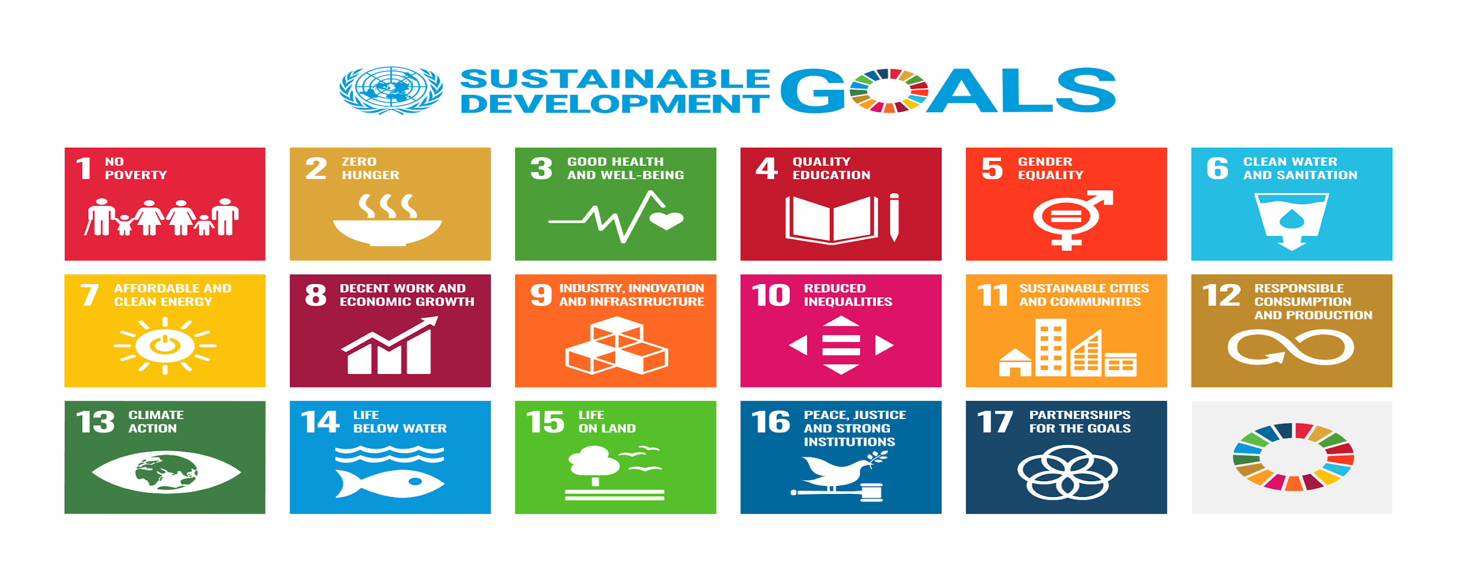
SDGS:
Quality Education, Industry, Innovation, and Infrastructure

Slide 6
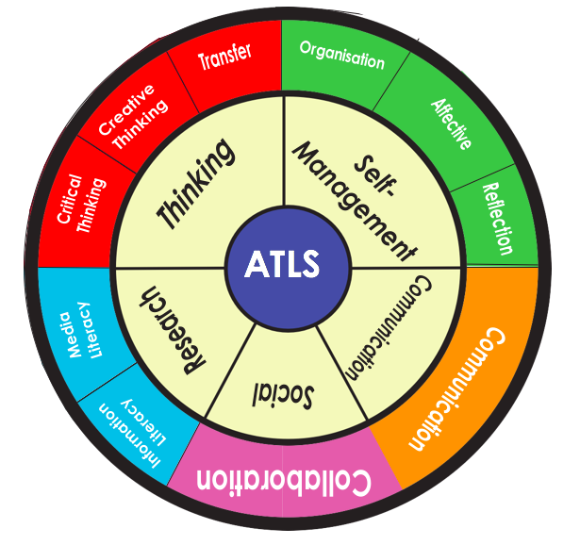
ATL skills:
Thinking Skills, Communication Skills

Slide 7
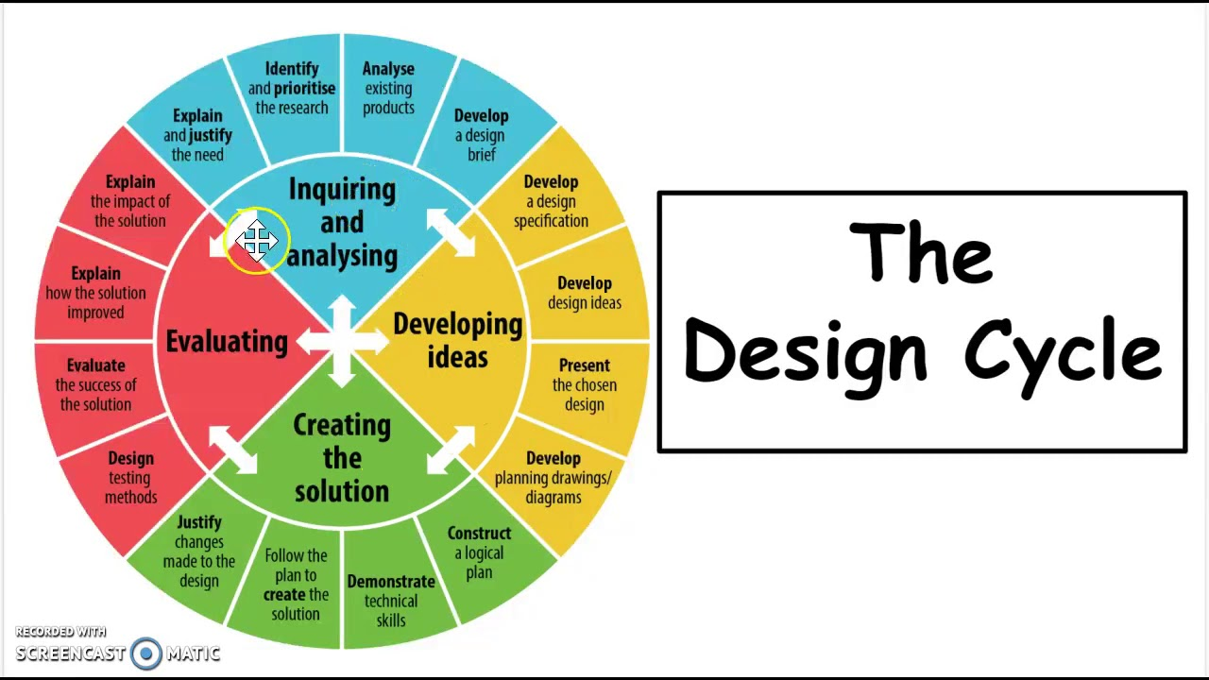

Slide 8
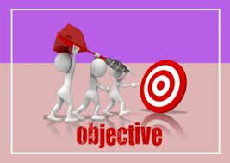
Lesson Objectives:
By the end of the lesson, students will:
Learn to create geometric shapes using AI tools in Pictoblox.
Reflect on how AI can impact creativity, design processes, and society.
Evaluate their design process and how their AI-created designs meet specific goals and criteria.

Slide 10
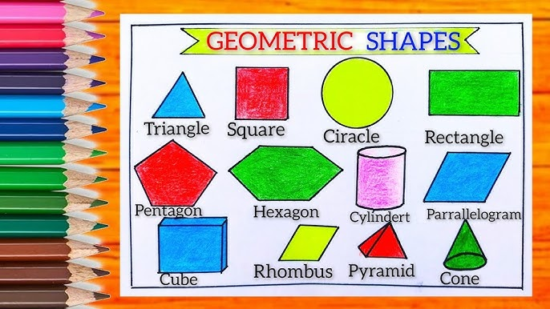
Each team: create a geometric shape using different colors(5 points) :

Slide 11
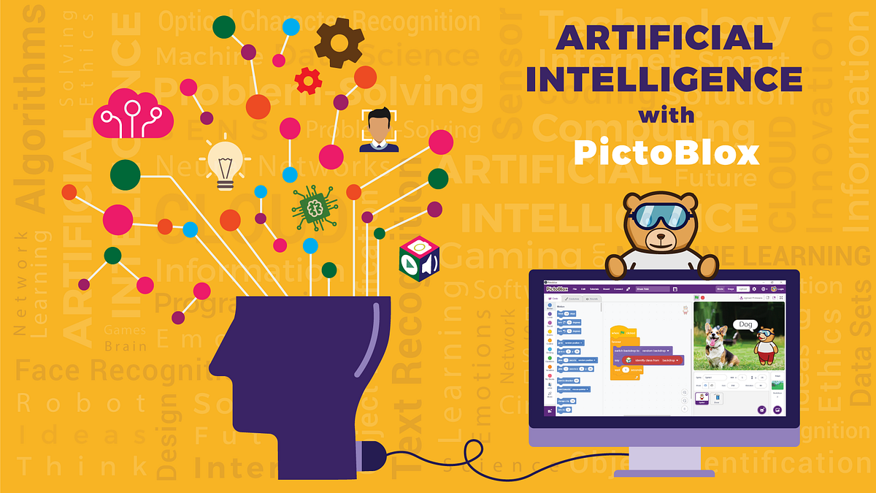
Creating Geometrical Shapes Using AI in Pictoblox

Slide 12
Let’s create it:
https://youtu.be/yJ5xy_Zwqyk
https://youtu.be/1lQ1DGtS7mo
https://youtu.be/x6UZW5U0XeE

Slide 13

Criterion D i- Reflecting on the impact of the solution:
Do you think AI is a helpful tool in art and design, or does it take away from the creativity of the artist?

